Slide 1
Rare Earth Hydrogen Storage Alloy Industry
Current Situation & Development Trend
Presenter: Jinyu Li
Company: XTC Hydrogen Energy Science and Technology (Xiamen) Ltd.

Slide 2
01
Basic Information
- Rare Earth Hydrogen Storage Alloy
02
Current Situation
- Hydrogen Storage Alloy Industry
03
Development Trend
- Hydrogen Storage Alloy
04
Future Outlook

Slide 3
01
  Basic Information
  - Rare Earth Hydrogen Storage Alloy

Slide 4
1.1 Hydrogen Storage Alloy Types
01
Magnesium-base Type
AB₅ Type
02
Pr, Nd-free, low-Co
Calcium-base Type
Hydrogen Storage Materials of Intermetallic Compounds
03
Rare Earth-base Type
A₂B₇ Type
04
Zirconium-base Type
La-Mg-Ni
La-Y-Ni
05
Titanium-base Type

Slide 5
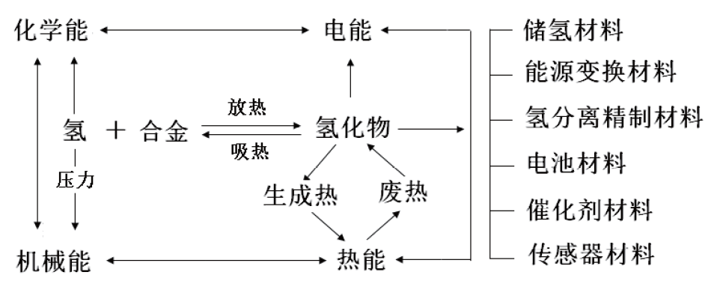
1.2 Major Applications of Rare Earth Hydrogen Storage Alloy
Major Applications of Rare Earth Hydrogen Storage Alloy
Type | Main Applications and Principles
Electrode Material | Metal hydride (MH) electrode, electrochemical absorption of hydrogen / medium release, MH/Ni battery, MH/Air battery
Hydrogen Storage Material | Medium for direct hydrogen storage and transport, hydrogen storage tank, hydrogen supply system for fuel cells
Heat Storage Material | Metal hydride reaction thermal effect, extra heat storage, thermal energy transfer, air conditioning heat pump
Hydrogen Separation Material | Selective absorption on hydrogen and hydrogen isotopes
Catalytic Material | Provide highly reactive hydrogen source for reactions involving hydrogen.
Energy Storage Material | Regulation on wind power and electric energy, etc.

Slide 6
1.3 Electrode Material
Type | AB₅ |  | AB_{3-3.5}
Alloy | LaNi₅ | MmNi₅ | LaNi₃ | CaNi₃ | La_{0.7}Mg_{0.3}Ni_{2.8}Co_{0.5}
Hydride | LaNi₅H₆ | MmNi₅H_{6.3} | LaNi₃H_{4.5} | CaNi₃H_{4.4} | La_{0.7}Mg_{0.3}Ni_{2.8}Co_{0.5}H_{4.73}
Hydrogen Absorption Capacity/wt.% | 1.4 | 1.4 | 1.4 | 2.0 | 1.6
Hydrogen discharge pressure (Temperature)/MPa（℃） | 0.4（50） | 3.4（80） | No Platform | 0.04 （20） | 0.06 （60）
Hydride Formation Heat/kJ·mol⁻¹H₂ | －30.1 | －26.4 |  | －35.0
Electrochemical Capacity mAh/g | 300-350 | 300-350 | 340-380 | \ | 340-380
The well proven commercial application for rare earth hydrogen storage alloy is hydrogen storage alloy LaNi5 (AB₅ type) and hydrogen storage alloy La-Mg-Ni (A₂B₇ type) in the Ni-MH battery industry.

Slide 7
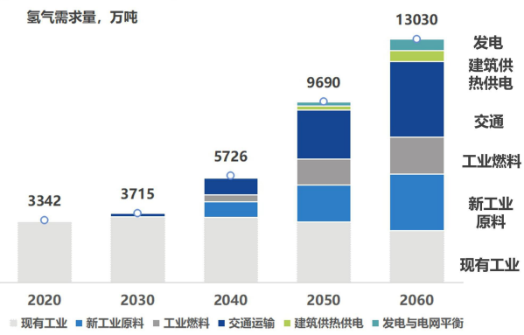
1.4 Hydrogen Storage Material – Solid State Storage
Hydrogen energy is the national strategic development, included in the 14th Five-Year Strategic Plan and the 2035 vision goal outline.
Renewable hydrogen output is expected to reach 100 million tons by 2060, attributed to about 15% of carbon dioxide emission reduction.
Hydrogen Storage |  | Pressure MPa | Temperature ℃ | Mass Hydrogen Storage Capacity wt. % | Volumetric hydrogen storage capacity kg m⁻³ | Energy Consumption %H₂
Vehicle Hydrogen Storage DOE(2020) |  | 0.5~1.2 | -40～60 | 5.5 | 40 | -
High Pressure Compression | 35MPa | 35 | 20 | 3.5 | 23.5 | ~10
 | 70MPa | 70 | 20 | 5.5 | 40 | ~20
Cryogenic Liquefaction | Liquid Hydrogen | 0.1 | -253 | 100 | 70 | ~30
Solid-state Hydrogen Storage | Rare earth hydrogen storage (AB₅，superstructure, etc.) | 0.01～3 | 20 | 1.4~1.6 | ~100 | <1
China’s White Paper on Hydrogen Energy and Fuel Cell Industry (2020)
Hydrogen storage plays a key role in hydrogen energy development and rare earth hydrogen storage is one of the most promising hydrogen storage technologies.

Slide 8
1.4 Hydrogen Storage Material – Solid State Storage
International
Domestic
Subject | Fruit Applications | Researcher
RE, Mg-based Hydrogen Storage Alloy | PEM Fuel Cell (1.3~1.5wt%) | Canada Hera Hydrogen Storage Systems Inc.
Superlattice Rare Earth Hydrogen Storage Material | Gas-solid hydrogen storage and Ni-MH battery (reversible hydrogen storage 1.8 wt%，efficient~1.6wt%) | Osaka National Research Institute of Japan
Multiphase Rare Earth Hydrogen Storage Alloy | Fuel cell, metal hydride cell (1.3~1.6 wt%） | BASF
Alloy Hydrogen Storage Material and Solid-state Hydrogen Storage Equipment | Used in fuel cell submarine and exports (~1.7wt%）
Solid-state Hydrogen Storage and Applications | Applying demonstration of Megawatt-level electrolytic cells and fuel cells (260Kg H₂） | U.K. GKN
Subject | Fruit Applications | Researcher
Rare Earth Hydrogen Storage Material and Application Tech | 1.5~3.5t fuel cell forklift and single-B system (consume 2.0wt%，release 1.8wt%) | Jiangxi Institute of Rare Earths, Chinese Academy of Sciences (CAS)
Rare Earth Alloy Hydrogen Storage, Heating Lithium and Control System Integration | Rare earth alloy hydrogen storage torch for the 2022 Beijing Winter Olympics(（BCC，hydrogen-release 2.8wt%） | Process Engineering Institute, CAS & Jiangxi Institute of Rare Earth, CAS
LaNi₅ Hydrogen Storage Alloy | Solid-state hydrogen storage used for fuel cell bicycles (1.4wt%) | China Iron and Steel Research Institute
TiFe-based Solid-state Hydrogen Storage Tech | On-line running with 60kw fuel cells (1.46wt%, 53kg/m³) | Shanghai Institute of Microsystems and Information Technology, CAS
Preparation and Application of RE Hydrogen Storage Materials | Applications for hydrogen storage alloy in vehicle ( ~1.7wt%) | Beijing General Research Institute for Nonferrous Metals
Germany Horvac Group
RE hydrogen storage capacity needs to be expanded further, and there are certain disparities for systems and applications of solid-state hydrogen storage in comparing with foreign ones.

Slide 9
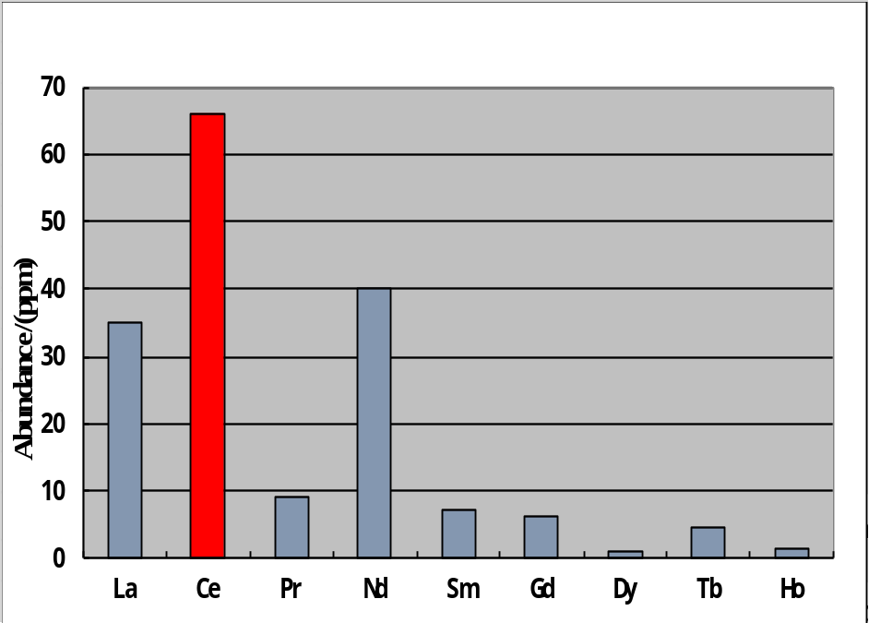
1.5 Significance of Rare Earth Resources Rational Utilization
High-abundance Rare Earth
Develop high-abundance rare earth hydrogen storage alloy
Sustainable Development on Rare Earth Resource
Parallel
Interact
High-abundance rare earth hydrogen storage alloy applications in Ni-MH cells
Resource：U.S. Geological Survey
Rare earth permanent magnetic materials take advantages of praseodymium, neodymium and other light rare earth metal to partly enrich certain light rare earth like lanthanum and cerium. Significant cost reduction will be achieved through replacement of low-cost lanthanum and cerium for mixed rare earth, representing rational utilization of rare earth resource and motivation to push forward sustainable rare earth development.

Slide 10
02
  Current Situation
  - Hydrogen Storage Alloy Industry

Slide 11
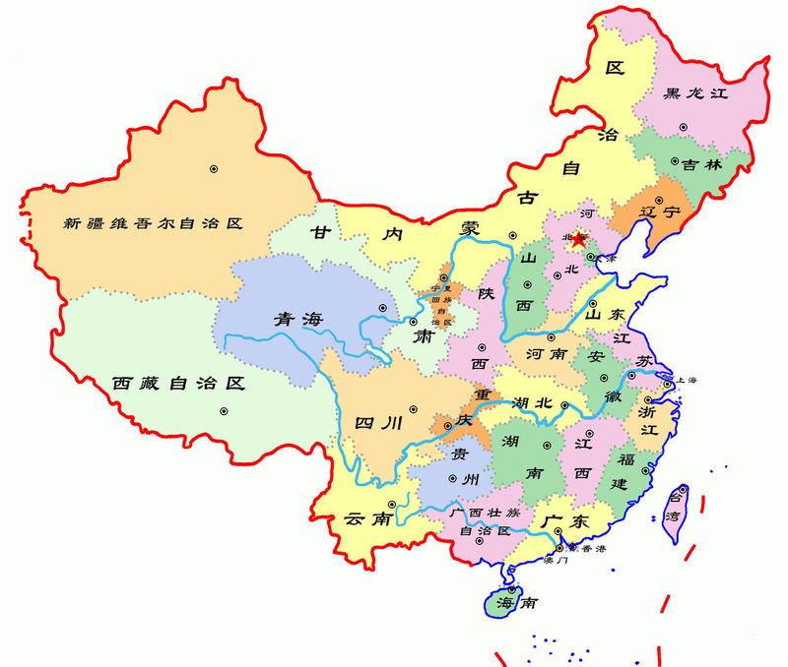
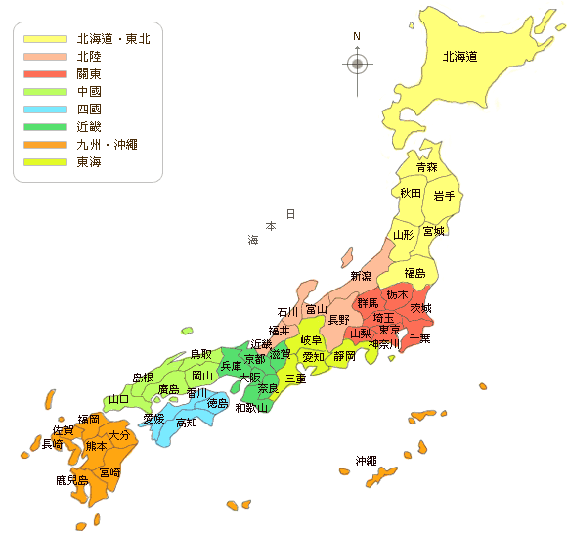
2.1 Major Rare Earth Hydrogen Storage Alloy Producers at Home and Abroad
北京浩运
稀奥科、三德
鑫普
日本重化学工业（JMC）
甘肃稀土金科
徽山钢研
和盛源
宁波申江
江钨浩运
三德（研发）
新日本電工[Nippon Denko]旧中央电器（CDK）
厦门钨业
三井金属矿业
达博文、中山天骄
There are many producers of hydrogen storage alloy in China with a total production capacity of more than 250,000t, bringing excess capacity.
There are only three producers of hydrogen storage alloy in Japan, with a production capacity of more than 3,000t each contributing to a total capacity of about 15,000t. The capacity utilization rate is high.

Slide 12
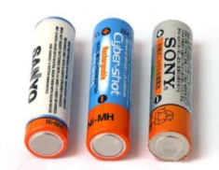
2.2 Small Ni-MH Cell Applications in People’s Livelihood
Cordless Telephone
Household Appliances
Personal Care
Driven by Covid-19 epidemic, sales of armarium, personal care and toy saw significant increase in 2020 and fell back and stabilize after the epidemic.
Toy
Armarium
Electric Tool
Hydrogen Storage Alloy is subdivided into conventional, high-capacity, power (driving force), low-temperature, high-temperature, low self-discharge, low-cost types and so on to meet various Ni-MH cell product demand.

Slide 13


2.2 Power Ni-MH Cell Applications in HEV
Xhev Functions | ISS（Start/Stop） |  | Micro Mixing | Slight Mixing |  | Mid Mixing |  | Strong Mixing | Plug-in Mixing
Start | ★ |  | ★ | ★ |  | ★ |  | ★ | ★
Regenerative Automaton |  |  | ★ | ★★ |  | ★★★ |  | ★★★ | ★★★
Ancillary Start |  |  |  | ★ |  | ★★ |  | ★★★ | ★★★
Power Assist |  |  |  | ★ |  | ★★ |  | ★★★ | ★★★
Pure-electric Driving |  |  |  |  |  | ★ |  | ★★ | ★★★
Battery Voltage/V | 12 |  | 12 | 36~48 |  | 100~200 |  | ＞150 | ＞150
Battery Type | Fluid-type Lead Battery
 | Control Valve Type Lead Battery
 |  |  |  |  | Ni-MH Battery
 |  |  |  |  | Lithium ion Battery
CO₂ Reduction/% | ＜4 | 4-7 |  |  | 8-12 |  | 12-15 | 15-20 | ＞20
Battery Producer | PEVE
Vehicle Model | Lexus LS600h
Nominal Voltage | 7.2V
Rated Power | 6.5Ah
Output Power | 1352W/6Cell Module
Weight | 1197g
Cell Unit | 288V
Alloy Feature | Superior Comprehensive Performance

Slide 14
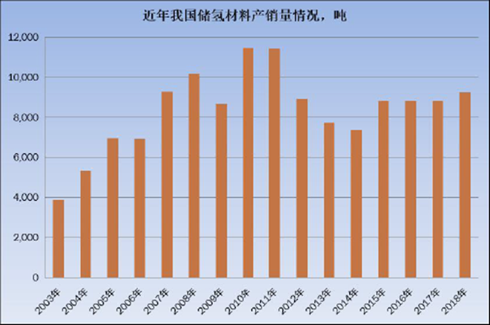
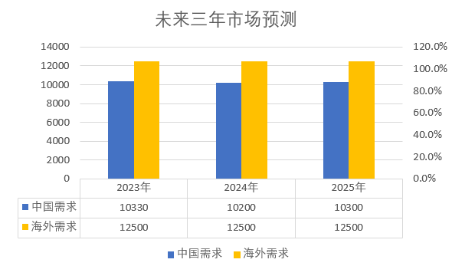
2.3 Production & Sales of Rare Earth Hydrogen Storage Materials
China’s annual sales of rare earth hydrogen storage materials basically maintain at 9,000t since 2011.
Rapid market development of Toyota Ni-MH mix-power vehicles pushed forward the growth of alloy powder market in the recent years.
Struck by lithium-ion battery development, production and sales of rare earth hydrogen storage materials declined in the civil market.

Slide 15







2.4 Company Milestones
Nov 8, 2022 - XTC Hydrogen Energy Science and Technology (Xiamen) Ltd. established
2022 – Work on “14th Five” National Key R&D Subject Missions
2021 – State-solid hydrogen storage AB2 series products sales exceeded 1 ton
2014 – Enter hybrid-vehicle battery market
2012 – Awarded “National Strategic Innovative Product” Title (PrNd-free)
2011 – AB3 alloy project played a leading role in National 863 Plan
2009 – Granted with new technology (splat cooling) equipment patent
2008 – Sales and production ranked first in China
Hydrogen Storage Alloy
2007 – 4000tpy new technology (splat cooling) production line started production
2002 – Commenced commercial production of AB5-series hydrogen storage alloy successfully

Slide 16
03
  Development Trend
  - Hydrogen Storage Alloy

Slide 17
3.1 Hydrogen Storage Alloy Market Growth Direction
1
Ni-MH Hybrid Vehicle Market
Growth Direction of Hydrogen Storage Alloy Market
In-car Backup Power Market
2
3
Applications for Rail Transit
4
Applications for Solid-state Hydrogen Storage

Slide 18
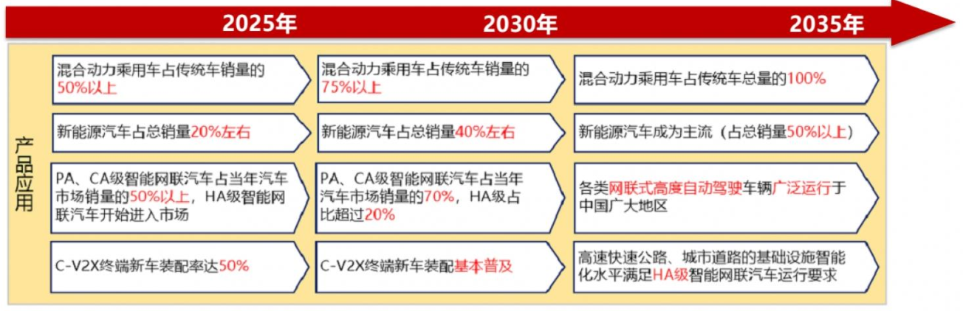
3.2 Ni-MH Hybrid Power Vehicle Market
《Energy Saving & New Energy Vehicle Technology Roadmap 2.0》——
By 2035，
  NEV prevails and its sales account for more than 50% of the whole market.
The sales of passenger cars reached 26.864 million vehicles in 2022, among which the sales of new energy vehicles were 6.887 million vehicles, up by 93.4% YoY, accounting for 25.6% of the market.

Slide 19
3.2 Ni-MH Hybrid Power Vehicle Market
Market Analysis on Toyota HEV with Ni-MH battery
It took 10 years in total for their global accumulated sales to exceed 1 million units for the first time!
Only 3 years to sell another 1 million units!
Only 8 months to achieve the recent 1-million sales volume!
Accumulated HEV sales in China only reached above 10,000 units by 2010.
Accumulated HEV sales in China reached 100,000 units by 2014.
Accumulated HEV sales in China broke through 1 million by 2020.
19

Slide 20
3.2 Ni-MH Hybrid Power Vehicle Market
Lithium-ion and Ni-MH batteries will be used in Toyota’s next generation of hybrid power vehicles as planned.
Lithium-ion Battery HEV is Toyota’s main technology route.
Lithium-ion and Ni-MH batteries also compete in the HEV field, which strengthens importance to reduce Ni-MH battery costs by reducing alloy costs to improve competitive advantages.
Phase II
Remove expensive heavy rare earth metals in vehicle-mounted alloys
Reduce contents of cobalt and nickel metal in vehicle-mounted alloys
Phase I

Slide 21
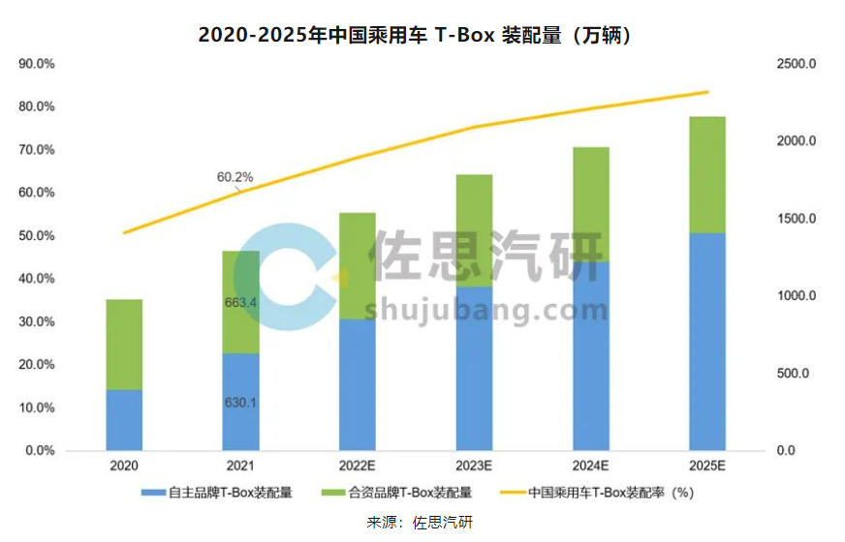
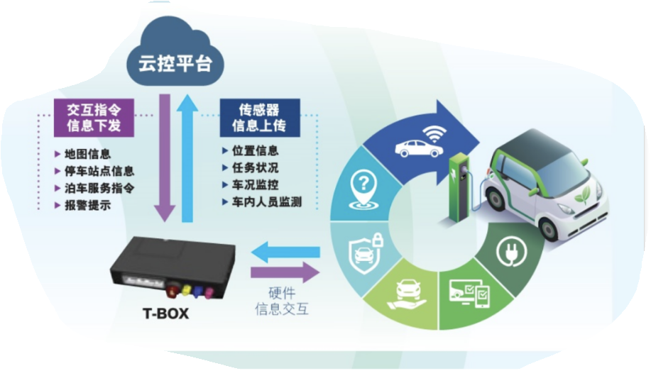
3.3 Vehicle-mounted Backup Battery Market
Vehicle-mounted end product industry (T-Box, in-car OBD, Tracker)
In 2021, China’s passenger cars assembled with T-Box reached 12.94 million units, up by 31% YoY, with an assembly rate of 60%.
Ni-MH battery is the best choice for T-BOX battery.
The assembly volume is predicted to exceed 20 million per year by 2025, with more than 40 million Ni-MH batteries equipped with.

Slide 22
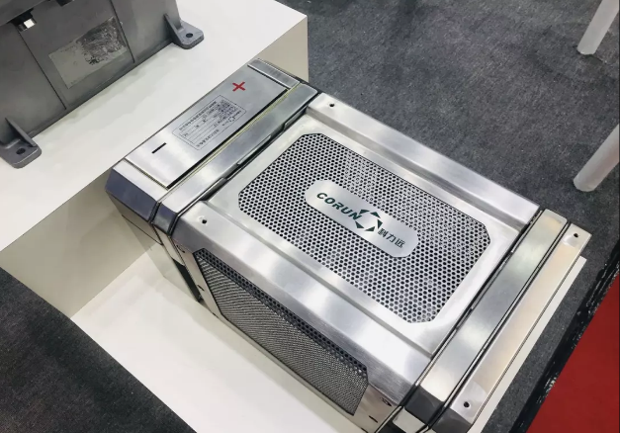
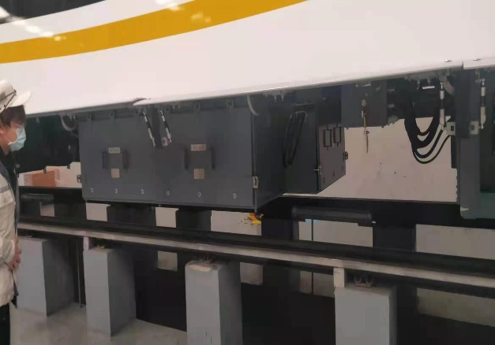
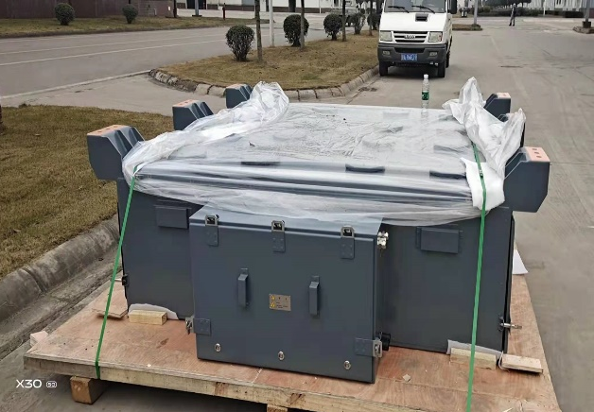
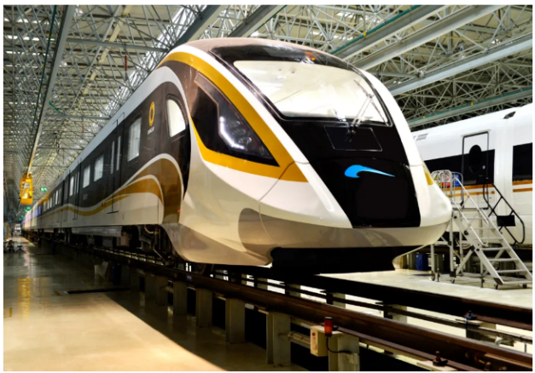
3.3 Vehicle-mounted Backup Battery Market
Market analysis on power supply products for rail traffic
At present, the most extensively used batteries in the rail traffic industry are lead-acid batteries and nickel-cadmium accumulators, which have problems of low energy density, high maintenance costs, great harm to the environment, poor safety, etc.
Compared to lithium-ion battery, Ni-MH battery has better adaptability to temperature and can work at -40℃～60℃ with higher safety, therefore it is the best choice for the power supply products for the future rail traffic.

Slide 23
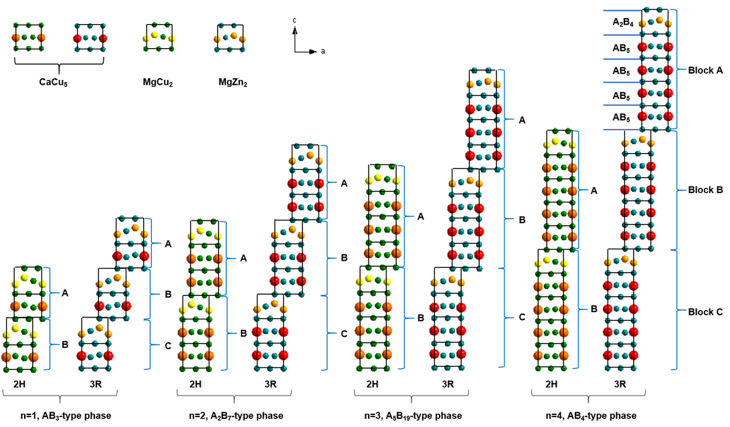

3.3 Vehicle-mounted Backup Battery Market
AB_{x} = (5n+4)/(n+2) (n = 1, 2, 3, 4)
1AB₅+1A₂B₄ = A₃B₉ ( AB₃ )
2AB₅+1A₂B₄ = A₄B₁₄ ( A₂B₇ )
3AB₅+1A₂B₄ = A₅B₁₉
4AB₅+1A₂B₄ = A₆B₂₄ ( AB₄ )
H (2H-Type)：Space Group P6₃/mmc
R (3R-Type)：Space Group R-3m
The low-temperature discharge performance of Ni-MH batteries is mainly determined by anode materials—hydrogen storage alloy.
Conventional AB5-type alloy has poor low-temperature discharge performance. Although hydrogen absorption and discharge platforms could be lifted up to meet the requirements for low-temperature discharge, while the higher platforms could bring other negative problems at high temperature and not be able to meet broad operating temperature demand.
Compared to AB5-type rare earth alloy, A2B7 alloy has the greater hydrogen storage capacity, better hydrogen storage kinetics and better adaptability to temperature which means it could work at -40~60ºC. A2B7-type alloy is the key R&D material for broad-operating-temperature Ni-MH battery.

Slide 24
3.4 Relative Applications on Solid-state Hydrogen Storage
In November 2021, the National Development & Reform Commission and the National Energy Administration issued new polices for low-carbon transformation, promoting hydrogen energy applications by a number of measures.
In March 2022, the 14th Five-Year Plan for New Energy Storage Development and Implementation was issued officially.
In April 2022, the 14th Five-Year Plan for Technological Innovation in Energy Field was issued.
New energy storage sees transformation from initial commercialization to large-scale development and has conditions to realize large-scale commercial application.
Promote clean-energy transportation means like hydrogen energy, and perfect hydrogen fueling station layout and service facilities.
Speed up studying, formulating and revising technology and safety standards in hydrogen energy and other fields.
Technology iteration and upgrading of hydrogen energy and fuel cells continuously accelerate.
Develop key technologies for high-efficiency hydrogen preparation and storage & transportation as well as fuel cells.
In March 2022, the Medium-Long Term Plan on Hydrogen Energy Industry Development (2021-2035) was released.
In December 2021, the Notice on Launching Demonstration Work of A New Batch of Fuel-cell Vehicles was issued.
Point out that hydrogen energy is an important part of the national energy system in the future and an important carrier to realize green low-carbon transformation with energy terminal.
In November 2021, “hydrogen” was written into many government documents.
Establish a sound coordination mechanism for demonstration and application, accelerate forming advanced experience that can be popularized for fuel-cell vehicle development.
《14th Five-Year Plan for Promoting Clean Production》
《14th Five-Year for Green Industrial Development》
Solid-state hydrogen storage is one of the most promising applications of hydrogen energy, having advantages of moderate storage conditions, high safety and high storage density.

Slide 25
3.4 Relative Applications on Solid-state Hydrogen Storage
 |  | Current | Near-term Target （2020-2025） | Medium-term Target （2026-2035） | Long-term Target （2036-2050）
Hydrogen Energy Proportion（%） |  | 2.7% | 4% | 5.9% | 10%
Industrial Output Value（100 million yuan） |  | 3000 | 10,000 | 50,000 | 120,000
Equipment Scale | Hydrogen Fueling Station (Unit) | 23 | 200 | 1500 | 10,000
 | Fuel-cell Vehicle（10,000 units） | 0.2 | 5 | 130 | 500
 | Stationary Power Supply / Station (Unit) | 200 | 1000 | 5000 | 20,000
 | Fuel-cell System（10,000 sets） | 1 | 6 | 150 | 550
Data Source: White Paper on China’s Hydrogen Energy Industry
Hydrogen energy industry will achieve rapid industrial development under the guidance of national policies and embrace enormous future potential of the market.
Technology and materials of hydrogen storage and transport are the bottleneck in the rapid and large-scale development of hydrogen energy industry. The market desperately demands high-capacity solid-state hydrogen storage materials and storage-transportation technology to support the storage and transportation system of hydrogen for the hydrogen industrial chain.

Slide 26
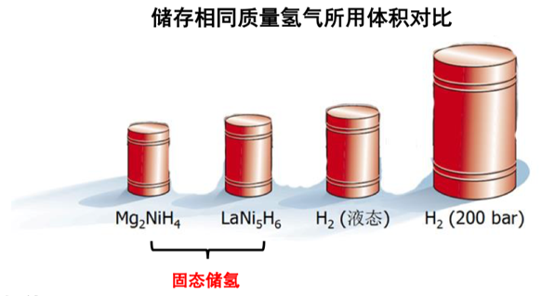
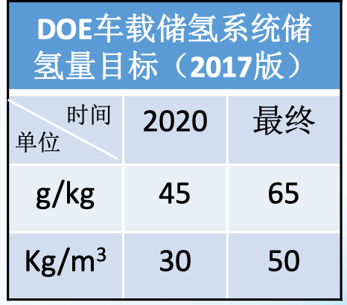
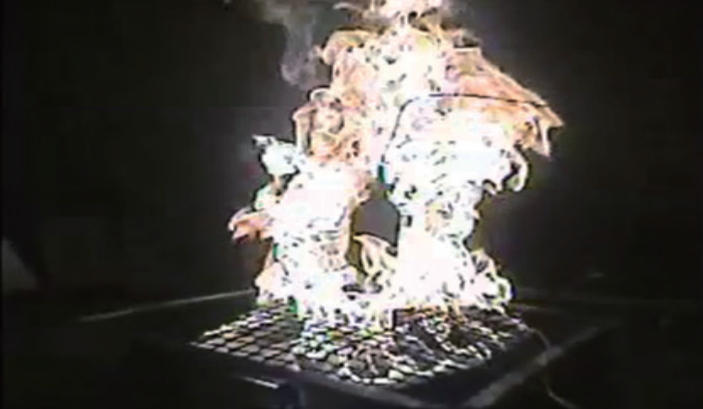
3.4 Relative Applications on Solid-state Hydrogen Storage
Gaseous hydrogen storage：
1）low energy density
2）poor safety
Liquified hydrogen storage：
1）High energy consumption
2）Ask high insulation
performance of storage tank
Solid-state hydrogen storage：
1）High hydrogen storage by volume 2）No need for high pressure and heat-insulted tank
3）Good safety without explosion risks
4）Possibility to get high-purity hydrogen and improve added value of hydrogen
The above characteristics make it have broad application prospects in specific scenarios.

Slide 27
3.4 Relative Applications on Solid-state Hydrogen Storage
Comparison between different hydrogen storage materials
 | Hydrogen Storage Material | Hydrogen Storage Capacity/wt% | Hydrogen Discharge Pressure/MPa & Temperature/°C | Time for Discharging 90% of hydrogen/min | Life Span | Material Cost
Hydrogen Storage Alloy | LaNi₅ | 1.5~1.6 | 0.2~0.8; 20℃ | ≤3 | Good | Rather Low
 | TiMn₂ | 1.6~1.8 | 0.5~1.0; 20℃ | ≤3 | Good | Low
 | TiFe | 2.0-2.1 | 0.2-0.3;0.8-1.0;20℃ | ≤3 | About Good | Low
Lightweight Hydrogen Storage Material | MgH₂ | 7.6 | 0.1; 290℃ | ≤20 | About Good | Rather High
 | Mg₂NiH₄ | 3.6 | 0.1; 250℃ | ≤20 | About Good | Rather High
 | MAIH₄ (M=Li、Na) | 7.5~ 10.6 | 0.1; 150℃， Discharge hydrogen by several steps | ≤120 | About Good | High
 | Li-Mg-N-H | 5.6 | 0.1; 90℃ | ≤120 | About Good | Rather High
Rare earth-type hydrogen storage alloy has poor ability to absorb hydrogen but good kinetics and well-developed industrial development. It is well used in wind-solar energy storage, such as solid-state hydrogen storage, and special vehicles and vessels, which ask high performance of safety and environmental protection but low demand for storage density.
After optimization of process and composition, the hydrogen absorption capacity of AB5-type hydrogen storage alloy can reach above 1.6wt%.

Slide 28
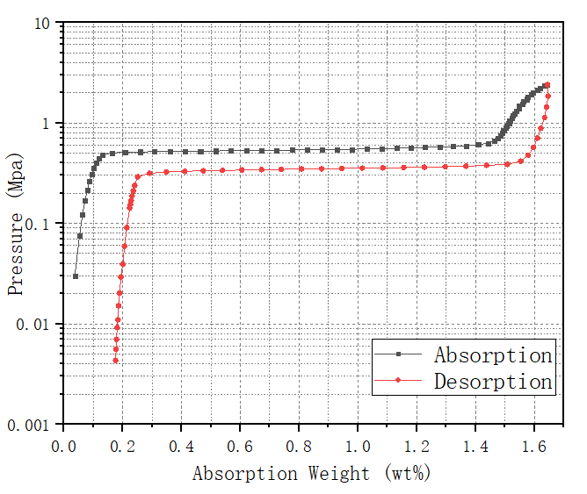
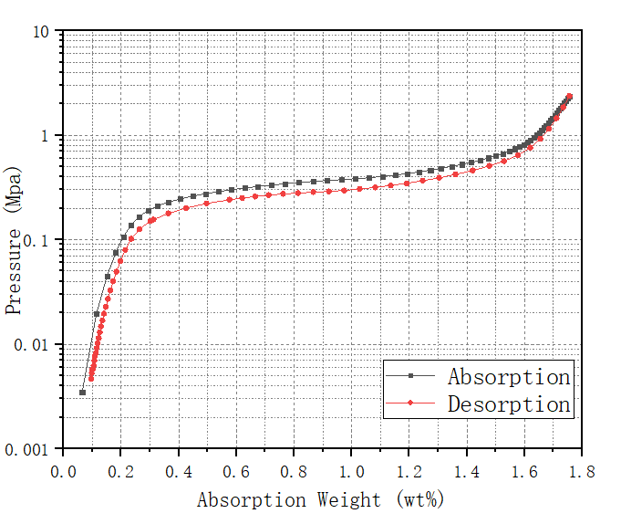
3.4 Relative Applications on Solid-state Hydrogen Storage
Solid-state hydrogen storage products produced by XTC
AB5-type Hydrogen Storage Alloy
AB2-type Hydrogen Storage Alloy

Slide 29

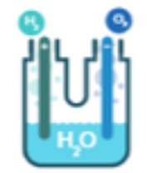
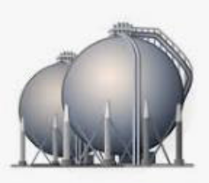

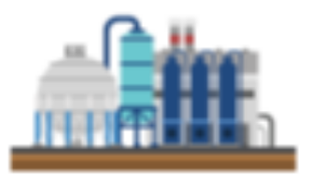
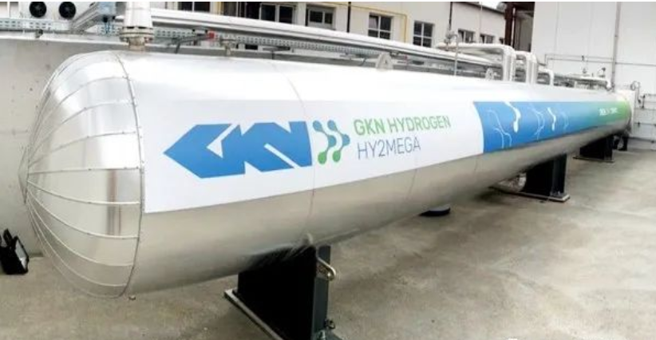
3.4 Relative Applications on Solid-state Hydrogen Storage
Renewable Energy
Water electrolysis to produce hydrogen
Combustion or reactor reaction for power generation
Solid-state hydrogen storage
Industrial by-product hydrogen
Wind/Solar Power Storage
Mainly include distributed solar power hydrogen storage system, wind power hydrogen storage system, etc.
Reserve Heat & Power Storage
Used in standby power supply of national power grid, factories, and households, etc.
2022-U.S. Energy Ministry Project
260kg/9MWh

Slide 30
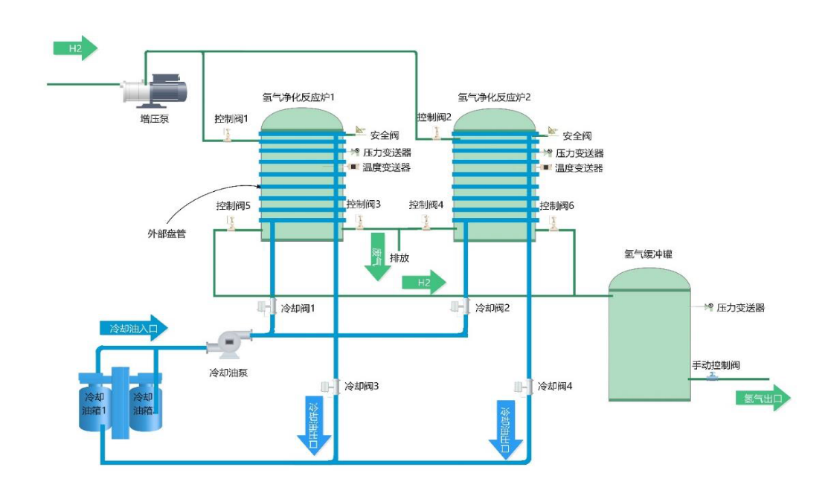
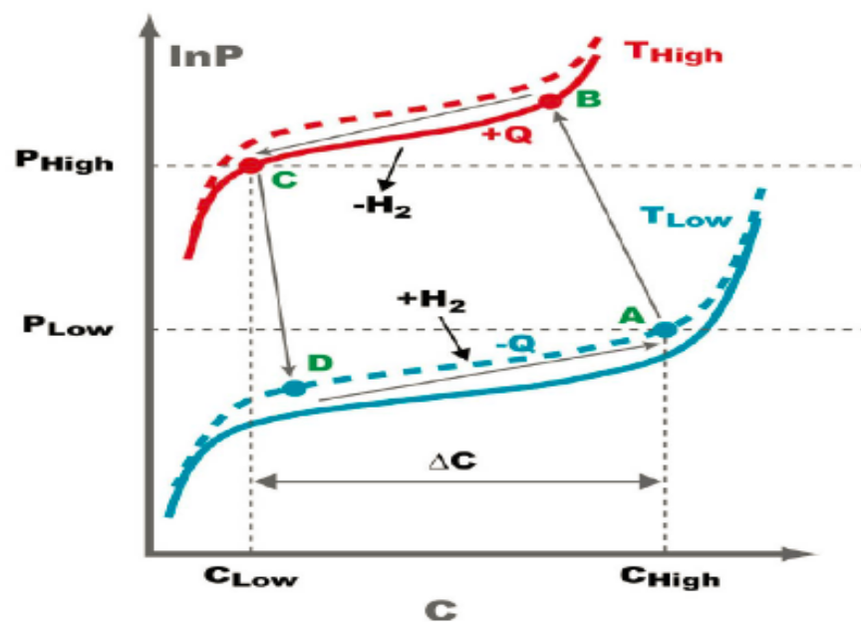
3.4 Relative Applications on Solid-state Hydrogen Storage
Hydrogen Purification
Take full advantage of purification ability of solid-state hydrogen storage materials to develop hydrogen purification systems that can work continuously and get hydrogen (>5N), on the basis of storage tanks.
Hydrogen Pressurization
Increase hydrogen pressure by multi-stage absorption and heating, and it’s reported that hydrogen pressure could be lifted from 0.1MPa to more than 70MPa now.

Slide 31
04
  Future Outlook

Slide 32
4.1 Bottleneck in Rare-Earth Hydrogen Storage Development
Weak R&D Ability
Slow Industrialization of New Materials
The national support to research and develop rare earth-based functional materials is inclined to rare earth magnetic materials and luminescent materials. While, the R&D teams usually change their research direction in the absence of funds.
Production process of hydrogen storage alloy such as La-Mg-Ni based alloy is complicated, and it’s difficult to ensure the uniformity and stability of alloy structure when to achieve industrialization.
Domestic overcapacity and enterprise management difficulties drag down industrialization of new materials.
In the application of wind-solar energy storage and Ni-MH batteries for energy storage, the high cost of rare earth hydrogen storage alloy is the biggest bottleneck. Therefore, it is necessary to further optimize the composition of raw materials and reduce the content of nickel and cobalt as well as expensive rare earth elements.
The hydrogen storage rate of rare earth hydrogen storage materials is rather low and has little advantage in the solid-state hydrogen storage industry, so it is necessary to improve the hydrogen absorption mass ratio.
To-be-improved Performance
To-be-reduced Cost

Slide 33
4.1 Bottleneck in Rare-Earth Hydrogen Storage Development
Ni-MH Battery：
Backup Power: The market of in-car backup power (e-call, T-box), rail traffic backup power and energy-storage backup power has enormous development potential, and Ni-MH battery has great advantages in the broad-temperature discharging field with a rather promising future.
In-car Power Battery: Toyota hybrid power vehicle sees rapid increased sales and contributes to the promising future of the global HEV market, expected to bring huge incremental value to the Ni-MH battery market.
Solid-state Hydrogen Storage：
Solid-state Hydrogen Storage System: The development of renewable energy resources like wind and solar energy is in urgent demand for energy storage systems to create stable power supply. However, such hydrogen storage system requires high safety and environmental protection as well as low mass storage density, for which it is suitable to use rare earth-base hydrogen storage materials.
In-car Fuel Hydrogen Supply System: Suitable for “Special (kind), High (frequency), Large (scale)” equipment fuel-cell industry. And at the same time, metal-base hydrogen storage alloy is well used in the fields which has counterweight requirements but asks low mass hydrogen storage density, such as forklift trucks, cranes. Moreover, small fuel-cell bicycle is another perfect application of rare earth-base hydrogen storage materials.

Slide 34
Thanks !
厦门钨业股份有限公司
XIAMEN TUNGSTEN CO.,LTD.
中国福建省厦门市海沧区海沧社区柯井300号 361026
No.300,Ke Jingshe, Haicang District,Xiamen,FuJian,China. P.C:361026

